Slide 1
The PolioPlus Society
Optional “grassroots” organization within districts to recognize PolioPlus donors
Requires annual pledge of typically $100 or more
All tracking done by districts
Recognized with pin, certificate
D7610 is adopting; most Zone 33 districts have adopted

Slide 2
Why Now?
Polio is still only a plane ride away as exemplified by the recent case of Paralytic Polio found in an unvaccinated adult in Rockland County, New York apparently brought to the U.S. by a visitor from another country

Slide 3
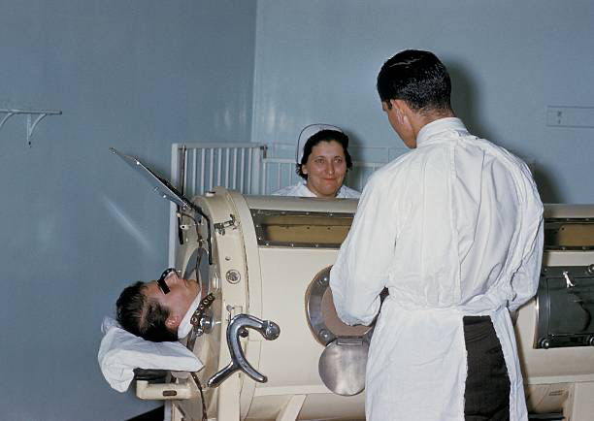
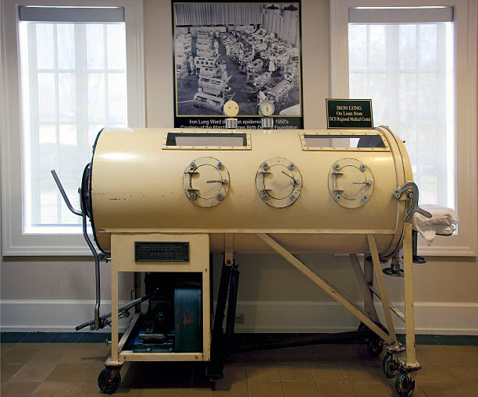
Before Polio Initiative, more than 1,000 children worldwide died every day – 350,000 children annually

Slide 4
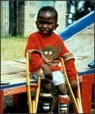
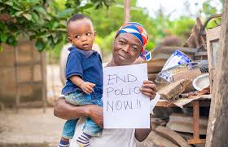
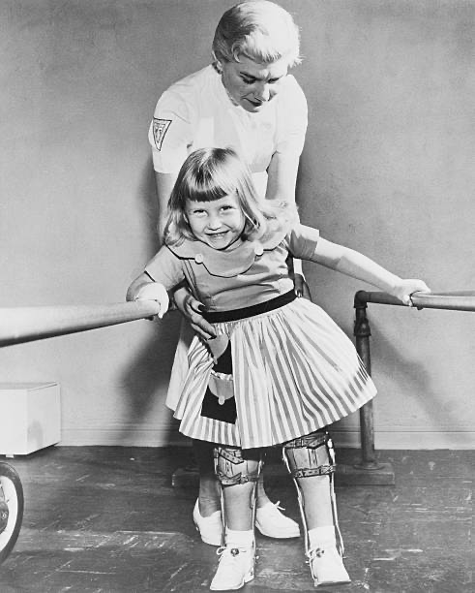
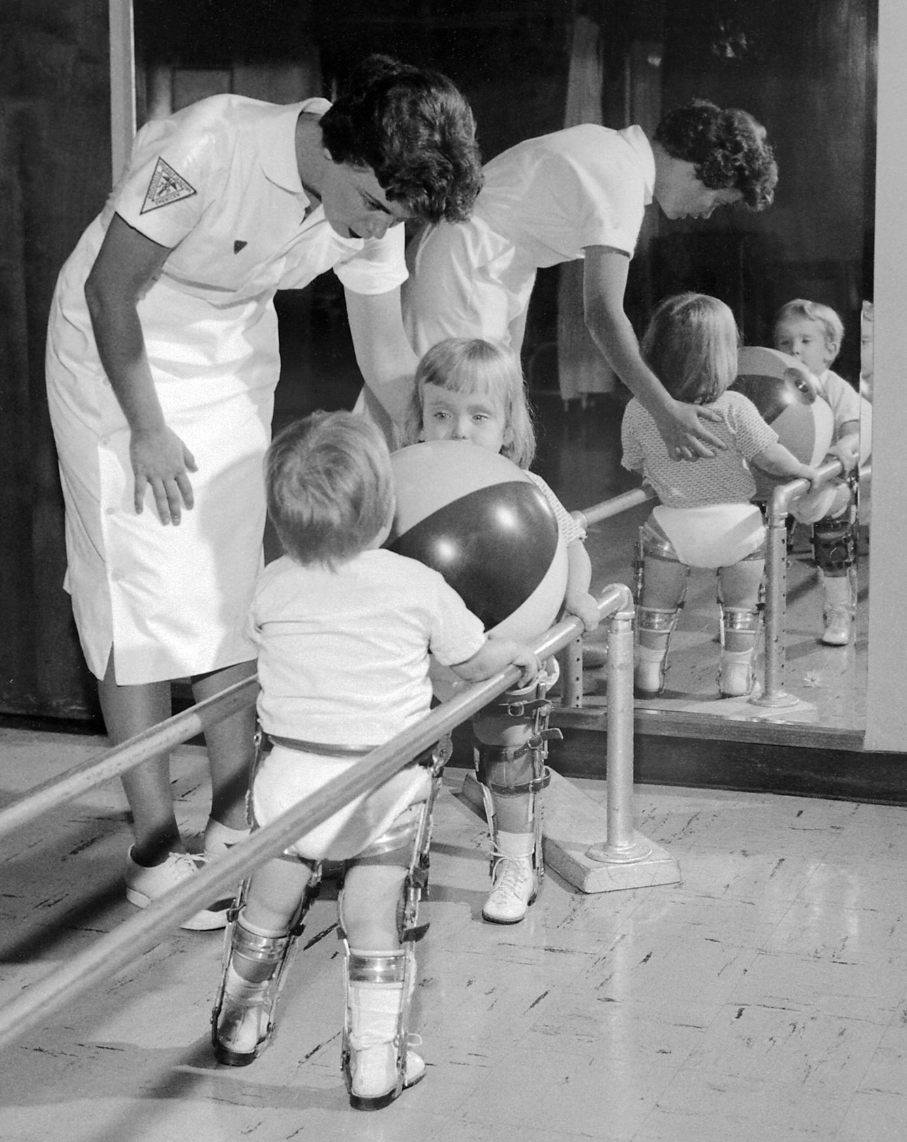
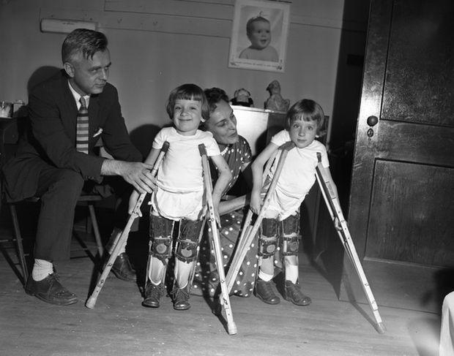
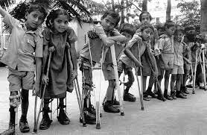
Why the PPS is Needed

Slide 5
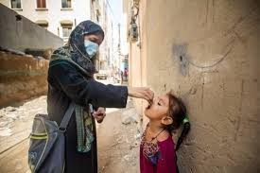
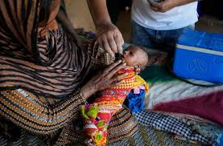
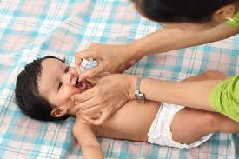
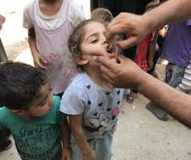
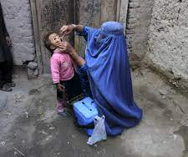
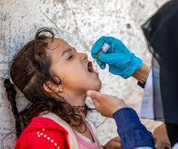
Drops That Save Lives

Slide 6
The Bill and Melinda Gates Foundation’s longstanding partnership with The Rotary Foundation to eradicate polio will match each dollar donated with an additional two dollars.
Join the PolioPlus Society and be a part of the fight to end polio and have your donation matched 2-to-1 by the Bill & Melinda Gates Foundation.

Slide 7
